Slide 1
Things Fall Apart
By Chinua Achebe

Slide 2
Things Fall Apart
The last four or five hundred years of European contact with Africa produced a body of literature that presented Africa in a very bad light and Africans in very lurid terms. The reason for this had to do with the need to justify the slave trade and slavery. … This continued until the Africans themselves, in the middle of the twentieth century, took into their own hands the telling of their story."
- (Chinua Achebe, "An African Voice")

Slide 3
Anticipation guide: True/False
A masculine man must be physically strong.
Women are intuitive about the health and care of their children.
Accidental manslaughter should be severely punished.
Ancestors have a great influence on our present day lives.
A parent should have much control over the future of her/his child.
Traditions should be kept and not questioned.

Slide 4
Things Fall Apart
Set in Nigeria in the late 1800s
Describes the arrival of white missionaries from Europe in an Ibo village and their effect on tribal life.
Okonkwo is the village hero; he’s a strong warrior with several wives and children.
Through an accident, Okonkwo loses his acceptance in the village.

Slide 5
Chinua Achebe
Wrote Things Fall Apart in 1958 (at age 28) in reaction to what he felt was racist or Euro-centric literature that demeaned Africans.
He also wanted to preserve and share tribal history and customs.

Slide 6
Chinua Achebe’s Biography
Achebe was born and raised in Southeastern Nigeria.
His parents were evangelical Christians, but inundated him with Ibo traditions as well.
He moved to London for his Master’s degree in 1953 and later to the U.S.
He was a professor at UMass and then Bard College in the 1970s and 1980s.
He is married and has 4 grown children.
In 1990, Achebe was in a serious car accident that left him paralyzed from the waist down.

Slide 7
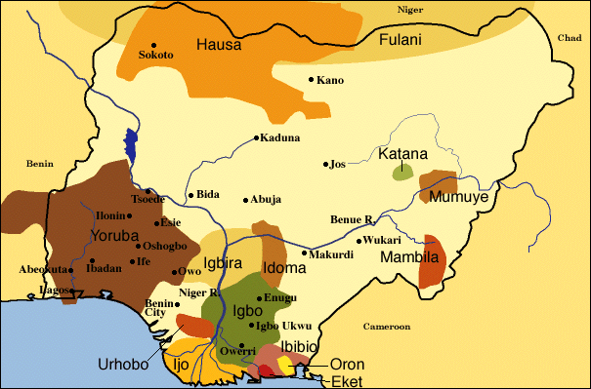
Nigeria and the Igbo People

Slide 8
Nigeria
Country: Nigeria (Federal Republic of Nigeria)
Location: West Africa
Independence: October 1, 1960
Nationality: Nigerian
Capital City: Abuja
Population: 123,337,822
Important Cities: Abuja, Lagos, Ibadan, Kano, Zaria, Ife, Abeokuta
Head of State: Umaru Yar'Adua
Area: 923,768 sq.km.
Type of Government: Republic
Currency: 132 Naira=1 USD
Major peoples: Yoruba,Igbo,Fulani,Hausa
Religion: Muslim 50%, Christian 40%, African religion 10%
Climate: Tropical to arid
Literacy: 57.1%
Official Language: English
Principal Languages: Yoruba, Igbo, Hausa,Fulani
Major Exports: Oil, Minerals, Cocoa, Rubber
“Nigeria.” Life and Art in Africa. 3 November 1998. Web. Accessed 2 May 2012.

Slide 9
The Igbo People
Location: Southeastern Nigeria
Population: 8 million
Language: Igbo (Kwa)
Economy: The majority of Igbo are farmers. Their staple crop is yam, and its harvesting is a time for great celebration. They are able to produce yam efficiently enough to export it to their neighbors. With the assistance of migrant labor, they also harvest the fruit of the palm tree, which is processed into palm oil, and exported to Europe in large quantities, making it a fairly profitable cash crop.
Political Systems: The Igbo are a politically fragmented group, with numerous divisions resulting from geographic differences. There are also various subgroups delineated in accordance with clan, lineage, and village affiliations. They have no centralized chieftaincy, hereditary aristocracy, or kingship customs, as can be found among their neighbors. Instead, the responsibility of leadership has traditionally been left to the village councils, which include the heads of lineages, elders, titled men, and men who have established themselves economically within the community. It is possible for an Igbo man, through personal success, to become the nominal leader of the council.
Religion: Before the influence of Europeans and Christian missions, however, most Igbo practiced some form of ancestor worship, which held that in order to gain success in this world, one must appease of the spirits of the deceased. This might be accomplished in any number of ways. One of the primary ways of showing respect for the dead was through participation in the secret men's society, Mmo, which is the name used only in the northern part of Igbo land. In other parts, similar societies exist under different names. The second level of initiates was responsible for carrying out the funeral ceremonies for the deceased and inducting the departed spirits into the ebe mmo, so that they would no longer cause mischief in the village.
“Igbo People.” Life and Art in Africa. 3 November 1998. Web. Accessed 2 May 2012.

Slide 10
Big Ideas and Themes
When tradition and modernity meet, does it always have to produce a conflict?
What is a tragic hero and how does Okonkwo fit our definition of one?
Should children try to follow in their parents’ footsteps? How important is it to make your parents happy?
Are certain cultures more “primitive” than others? What makes a culture primitive or civilized?

